Slide 1
Statistical Learning for Engineers
Automated Classification of Dry Bean Varieties Using Machine Learning
Group No. 6
Krishna Barfiwala
Niraj Gandhi
Mukund Bankar
Shaurin Karnik
Utkarsh Singh
Prof. Ramin Mohmmadi

Slide 2
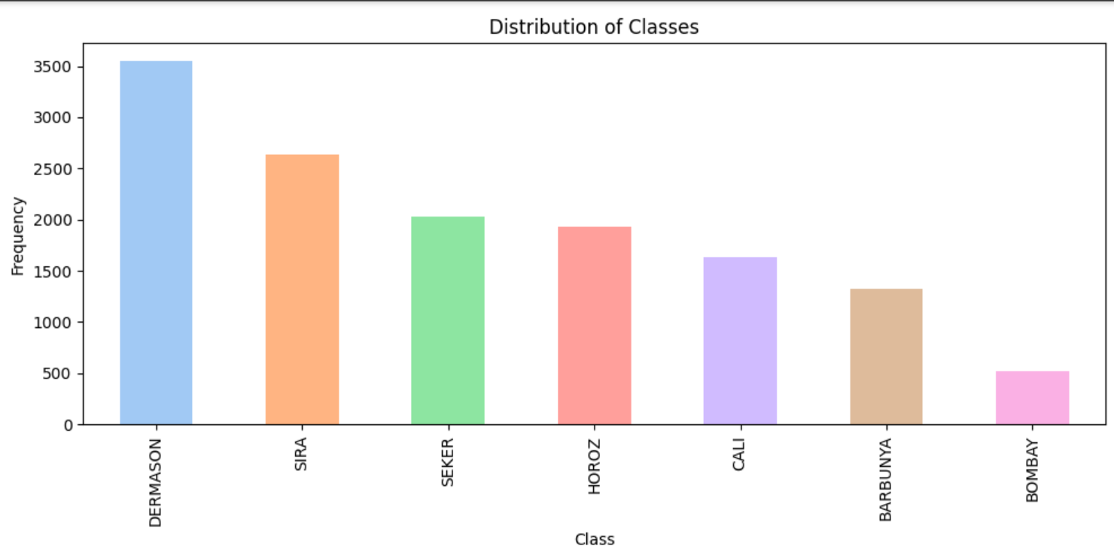
Exploratory Data Analysis - Class Distribution

Slide 3
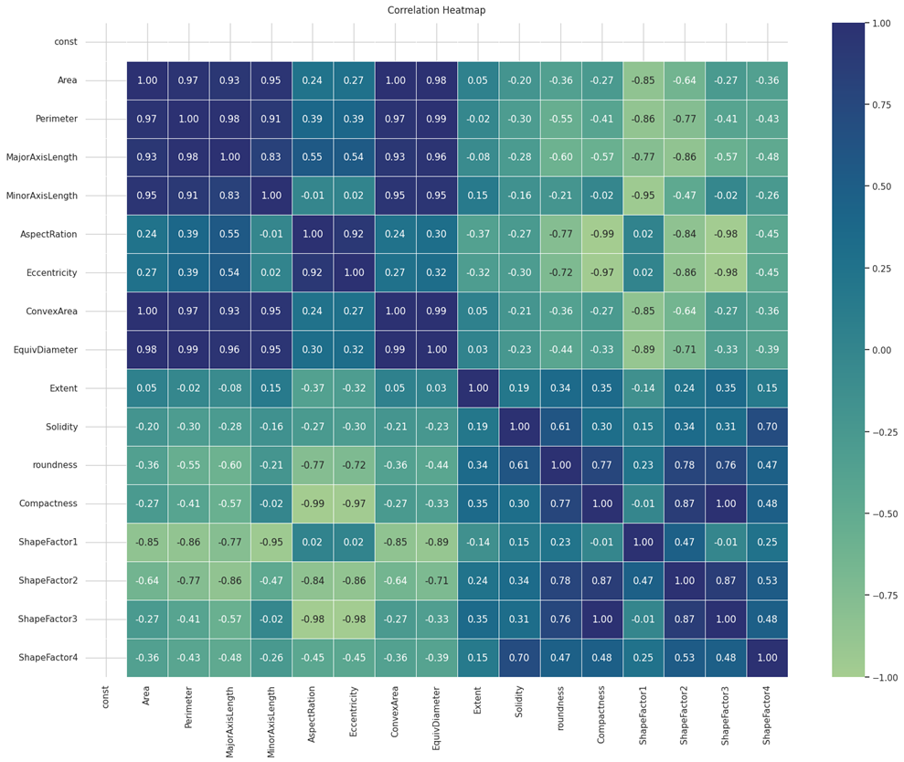
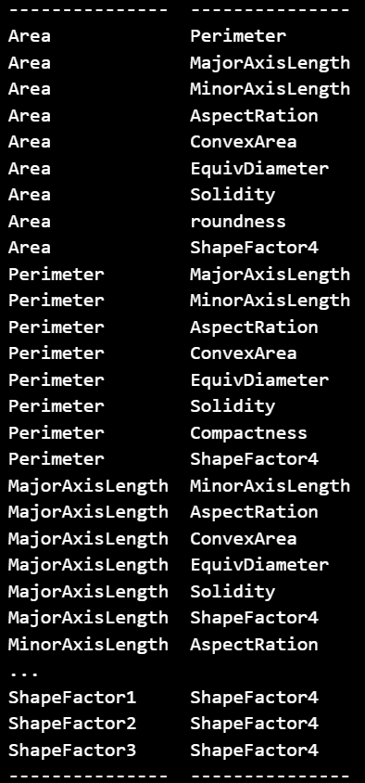
Exploratory Data Analysis – Correlation Heat Map
List of Highly correlated Attributes with correlation more than 95%.
Based on the data and documentation of the dataset – Perimeter and ShapeFactor4 were dropped

Slide 4
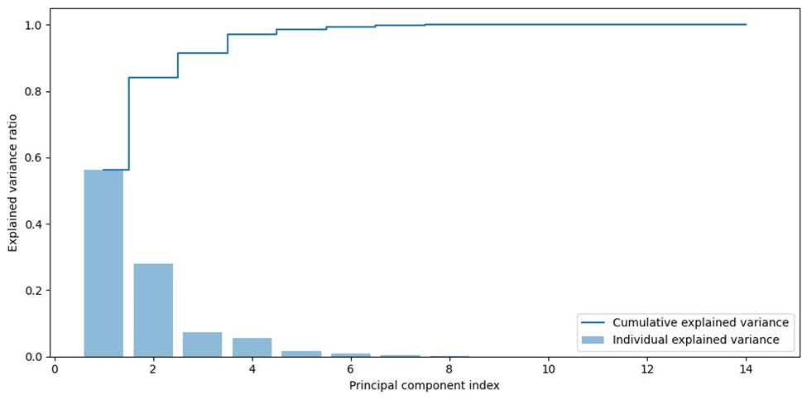
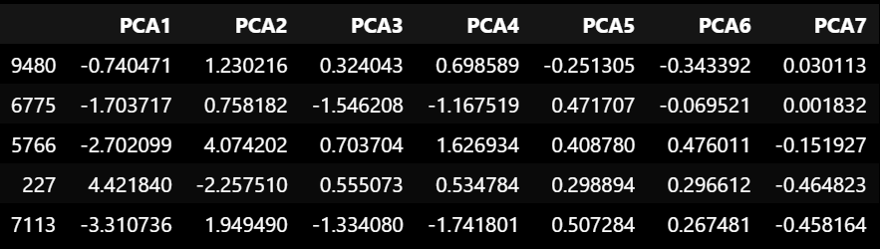
Principle Component Analysis

Slide 5
Machine Learning Models
Logistic Regression
Neural Network
Soft Margin Support Vector Machine

Slide 6
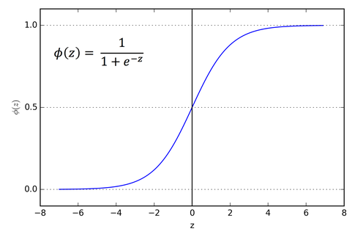
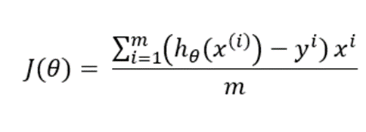
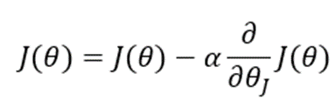
Logistic Regression
Classifies multiclass category of dry beans
Sigmoid and logit function are used
Gradient descent is used to minimize prediction error
There should be Linear combination of features and weights

Slide 7
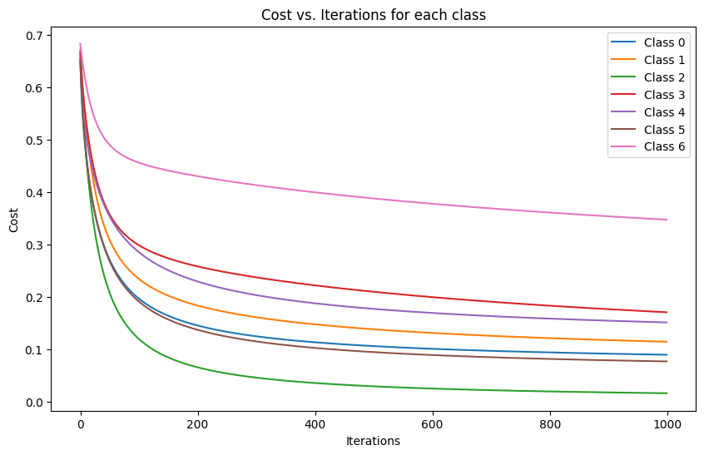
Logistic Regression
A good model has a smooth decreasing curve in the cost vs iterations graph for each class. This shows the model is improving to predict the dry bean Classes.

Slide 8
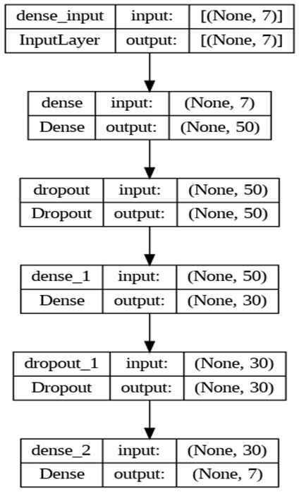
Neural Networks
4 standard Layers and 2 Dropout Layers
2 Hidden layers contain 50 and 30 Neurons respectively
Activation function: Rectified Linear Unit (ReLU)
Dropout layers after each hidden layers randomly drop 20% of the Neurons in order to prevent overfitting of the data
Model Snapshot

Slide 9
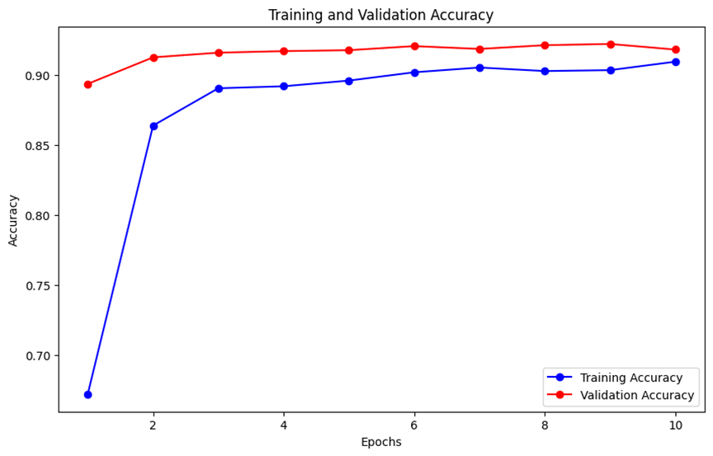
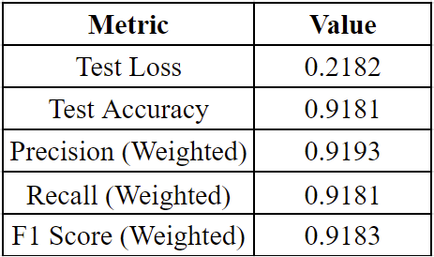
Neural Networks
Rapid improvement in the training and validation accuracy after the 1st epoch.
After 3rd epoch the accuracies begin to plateau which is an indication towards the convergence of the model to an optimal state.
The small gap between training and validation accuracy implies that the model is not overfitting significantly to training data
Final Metrics after running 10 Epochs

Slide 10
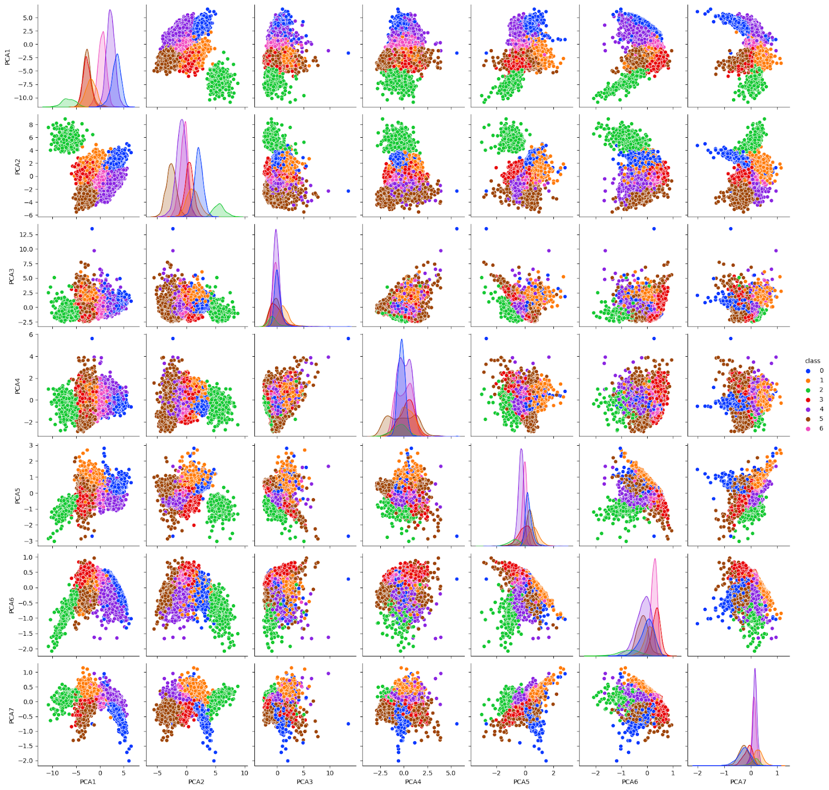
Soft-Margin SVM
The Soft Margin SVM represents a refined version of the classic Support Vector Machine, specifically designed for classification tasks. It permits a certain degree of error during training.
The dataset should be linearly separable for implementing SVM ,checked for linearity of data
The plot shows lack of inherent linear separability

Slide 11

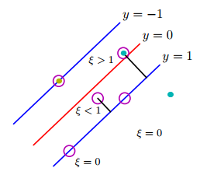
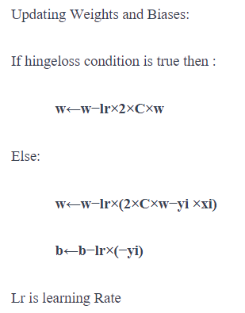
Soft-Margin SVM
ℎ𝑖𝑛𝑔𝑒𝑙𝑜𝑠𝑠=[0,1−𝑦𝑓(𝑥)]
Used one vs rest strategy, where individual binary SVM classifiers are trained for each class.

Slide 12
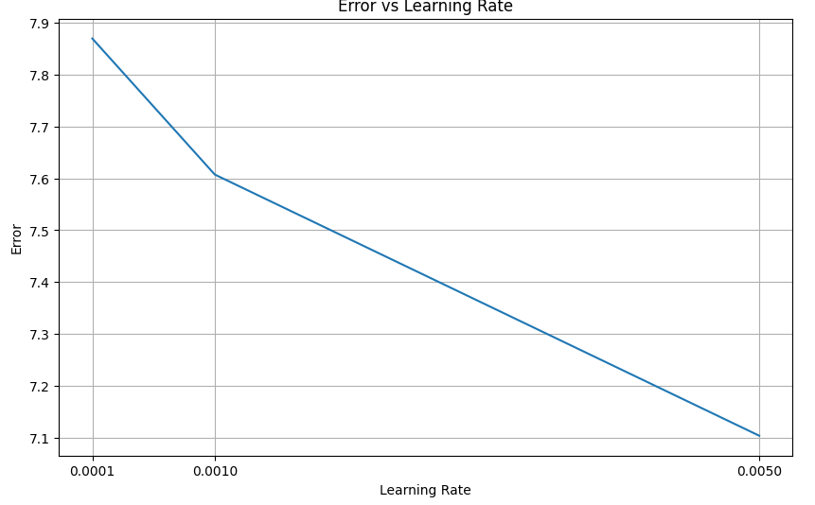
Soft-Margin SVM
SVM has a hyperparameter α, for getting an optimal model we implement Bias Variance Tradeoff.
When we implement different learning rates we found the ideal value to be 0.005
The model achieves an accuracy of 52%.

Slide 13
Model Comparison
 | F1- Score | Accuracy | Precision | Recall
Logistic Regression | 91.37% | 89.95% | 91.86% | 90.96%
Neural Nets | 91.83% | 91.81% | 91.13% | 91.81%
Soft Margin SVM | 47.40% | 52.11% | 45.62% | 52.11%

Slide 14
Conclusion
Neural Networks Best: Neural Networks are the best choice for these types of classification jobs. They do really well in key areas like F1-Score and Recall.
Logistic Regression Also Good: Logistic Regression is good too but not as good as Neural Networks. It's especially helpful for more complicated tasks.
Soft Margin SVM Not as Good: Soft Margin SVM doesn't perform as well. It might not be the right choice for this kind of work unless it's changed a lot.
Future Choice: For future projects that need accurate classification, Neural Networks are the go-to choice. Logistic Regression can be a backup for tougher tasks.

Slide 15
References
Dry Bean Dataset: https://archive.ics.uci.edu/dataset/602/dry+bean+dataset
Towards Data Science: https://towardsdatascience.com/support-vector-machines-svm-c9ef22815589
SVM: https://stats.stackexchange.com/questions/213687/svm-cost-function-old-and-new-definitions
Sigmoid Function: https://www.linkedin.com/pulse/understanding-sigmoid-function-logistic-regression-piduguralla/
Neural Networks: https://towardsdatascience.com/classification-using-neural-networks-b8e98f3a904f

